Slide 1

College of Science and Technology
School of ICT
Computer Science Department
Year 2
Lecturer: Muhayimana Odette
E-mail: muhayiodette06@gmail.com
Phone: 0788888571
CHAPII: ENTITY RELATIONSHIP MODEL
1

Slide 2

Concepts of ERD
Entities
An entity is a person, place, object, event, or concept in the user environment
about which the organization wishes to maintain data. In fact, we have to retrieve data from the database, and each of them should have a unique value to differentiate it from other different data. And when this this data can be uniquely identifiable, we call it “entity”, otherwise it is a simple object.
An entity can be either of physical existence in the real world (ex: person, house, etc.) or of conceptual/logical existence (ex: Bank account, course, etc.)
Note: In E-R model, we don’t represent the data but we represent the structure or schema. When we transform the E-R mode to relational model, then data can be stored into tabular format, hence represented as an entity.

Slide 3


Representation of an Entity
Examples
Weak entities
An entity set that does not have a primary key is referred to as a weak entity set.
The existence of a weak entity set depends on the existence of a strong entity set; it must relate to the strong set via a one-to-many relationship set.
The discriminator (or partial key/ foreign key) of a weak entity set is the set of attributes that distinguishes among all the entities of a weak entity set.
The primary key of a weak entity set is formed by the primary key of the strong entity set on which the weak entity set' existence dependent, plus the weak entity set’s discriminator (foreign key).
Strong entity is independent, having its primary key that uniquely identifies it from other entities. Its existence does not depend on other entities.

Slide 4
Entity Type
An entity type describes a collection of the entity having similar attributes.
Attributes
Each entity has a set of attributes associated with it. An attribute is a
property or characteristic of an entity that is of interest to the organization
(relationships may also have attributes, as we see in the section of relationships). Following are some typical entity types and associated attributes:
STUDENTS: Student_ID, Student_Name,Address, Phone_Number, Major AUTOMOBILES:Vehicle_ID, Color,Weight, Horsepower
EMPLOYEES: Employee_ID, Employee_Name,Address, Skill
Domain – the set of permitted values for each attribute

Slide 5

Type of Attributes
Simple attribute − Simple attributes are atomic values, which cannot be divided further.
For example: weight
Derived attribute − Derived attributes are the attributes that do not exist in the physical database, but their values are derived from other attributes present in the database.
For example: average_salary in a department should not be saved directly in the database, instead it can be derived.
Other example is age from Date of Birth and Today’s date.

Slide 6
Composite attribute − Composite attributes are made of more than one simple attribute.
For Example, Name can be divided into First name, Middle name and Last
name.
Single-value attribute − An attribute, that has a single value for a particular entity is known as single valued attributes.
For example, age, Social_Security_Number.
Multi-value attribute − An attributes that may have multiple values for the same entity is known as multi valued attributes.
For example colors of a car entity, a person can have more than one phone
number, email_address, etc.

Slide 7



Entity-Set and Keys
Key is an attribute or collection of attributes that uniquely identifies
an entity among entity set.
For example, the roll_number of a student makes him/her identifiable among students.
Super Key − A set of attributes (one or more) that collectively identifies an entity in an entity set.
Candidate Key − A minimal super key is called a candidate key. An entity set may have more than one candidate key.
Primary Key − A primary key is one of the candidate keys chosen by the database designer to uniquely identify the entity set.
Notes:
Primary key in ERD is underlined

Slide 8
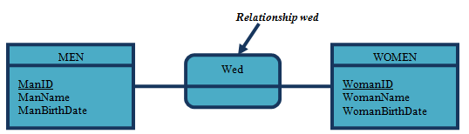
Relationships
Relationships are the glue that holds together the various components of an
ERD. A relationship is an association between the instances of one or more
entity types that are of interest to the organization. An association usually means that an event has occurred or that some natural linkage exists between entity instances. For this reason, relationships are labeled with verb phrases.

Slide 9
Degree of the Relationship
The degree of a relationship is the number of entities that participate in that relationship. The three most common relationships in ERD are unary (degree one), binary (degree two), and ternary (degree three). Higher-degree relationships are possible, but they are rarely encountered in practice, so we restrict our discussion to these three cases.
Unary Relationship. Also called a recursive relationship, a unary relationship
is a relationship between the instances of one entity.
Binary Relationship. A binary relationship is a relationship between instances of two entities and is the most common type of relationship encountered in data modeling.
Ternary Relationship. A ternary relationship is a simultaneous relationship among instances of three entities.

Slide 10
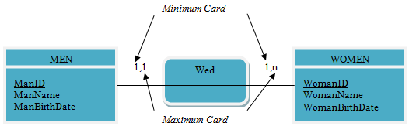
Cardinalities in Relationships
Suppose that two entities, A and B, are connected by a relationship. The
cardinality of a relationship is the number of instances of entity B that can (or
must) be associated with each instance of entity A.
The minimum cardinality that is the minimum number of times that an occurrence participates to a relationship
The maximum cardinality that is the maximum number of times that an occurrence participates to a relationship

Slide 11
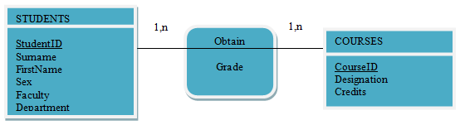
Associative Entities
As mentioned above, a relationship can contain attributes. For example, suppose
that a student studies different courses and obtains a grade for each and every course. It is clear that the grade obtained is not an attribute of STUDENTS because the student will sit for many courses and that the grade also depends of the course. So Grade is a property of the relationship between STUDENTS and COURSES. The attribute is associated with the relationship and diagrammed as follows:

Slide 12



E-R Diagram Components
Rectangles represent entity sets.
Double rectangles Represent weak entity sets
Ellipses represent attributes.
Diamonds represent relationship sets.
Lines link attributes to entity sets and entity sets to relationship sets.
Double ellipses represent multivalued attributes.
Dashed ellipses denote derived attributes.
Primary key attributes are underlined.

Slide 13

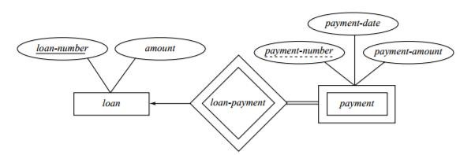
ER Diagram Representation
Entity
Entities are represented by means of rectangles.
Rectangles are named with the entity set they represent.
Weak entity
Weak entities are represented by double rectangles

Slide 14
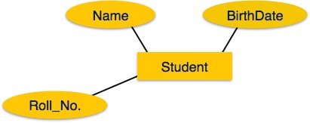
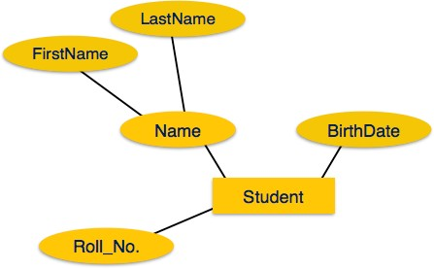
Attributes
Attributes are represented by means of ellipses.
Every ellipse represents one attribute and is directly connected to its entity (rectangle).
If the attributes are composite, they are further divided in a tree like structure.

Slide 15
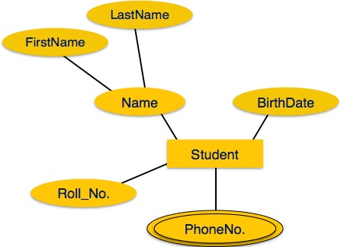
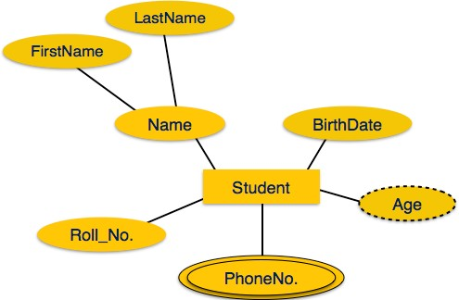
Multivalued attributes are depicted by double ellipse.
Derived attributes are depicted by dashed ellipse.

Slide 16
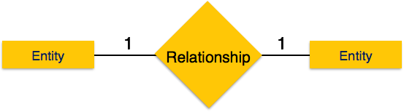
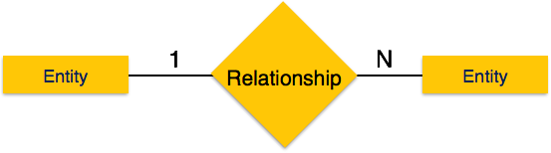
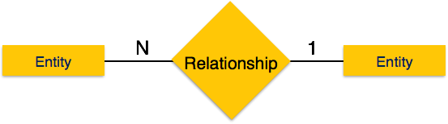
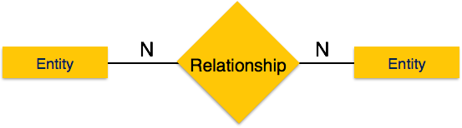
Relationship:
One-to-one
One-to-many
.
Many-to-one
Many-to-many

Slide 17




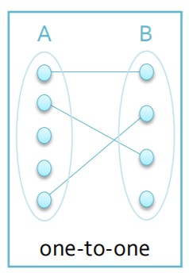
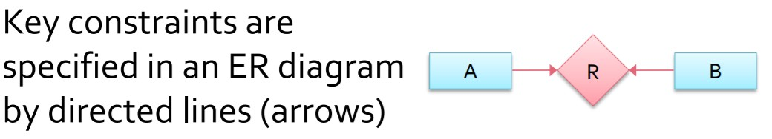
One-to-one relationship
An entity in entity set A can be associated with at most one entity in entity set B and An entity in entity set B can be associated with at most one entity in entity set A

Slide 18

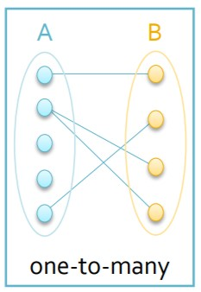
One-to-many relationship
An entity in entity set A can be associated with any numbers of entities in entity set B and An entity in entity set B can be associated with at most one entity in entity set A

Slide 19
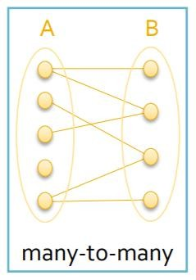
An entity in entity set A can be associated with any numbers of entities in entity set B and An entity in entity set B can be associated with any numbers of entities in entity set A

Slide 20

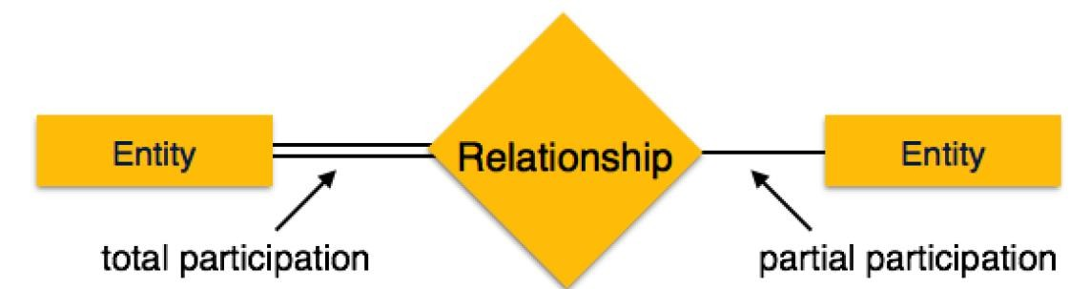
Participation Constraints
Total Participation − Each entity is involved in the relationship.Total participation is represented by double lines.
Partial participation − Not all entities are involved in the relationship.
Partial participation is represented by single lines.

Slide 21

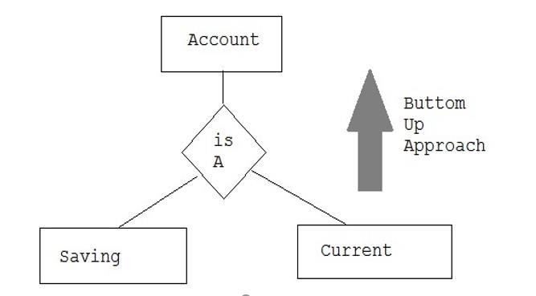
Generalization
Generalization is bottom up approach in which two lower level entities combine to form a higher level entity. In generalization, the higher level entity can also combine with other lower level entity to make further higher level entity

Slide 22

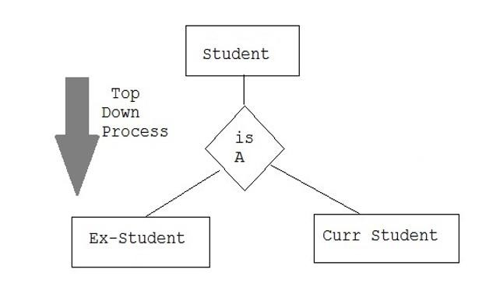
Specialization
Specialization is opposite to generalization. It is an top-down approach in which a one higher level entity can be broken down into two lower level entity. In specialization, some higher level entities may not have lower level Entity sets at all.

Slide 23

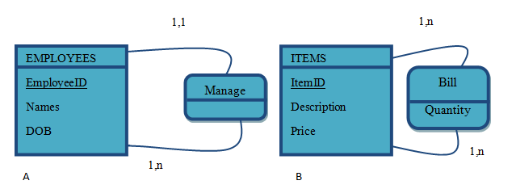
Logical Data Model (LDM)
In the logical level, the Entity-Relationship Model is translated into the Logical Data Model (LDM). It presents a more comprehensive view of the database architecture.
Transforming Unary Relationship
Let us consider the following 1:N (A) and M:N (B) unary relationships:

Slide 24
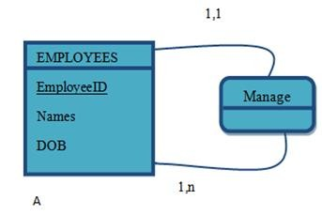
One to Many (1:N) Unary Relationship
For a unary (1:N) relationship, the entity is modeled as a table. The primary key of that relation is the same as for the entity. Then a foreign key is added to the table that references the primary key values. A recursive foreign key is a foreign key in a table that references the primary key values of that same table. The result is the following:
EMPLOYEES (EmployeeID, Names, DOB, ManagerID#)
In this table, ManagerID is a recursive foreign key that takes its values from the same set of worker identification numbers as EmployeeID.

Slide 25
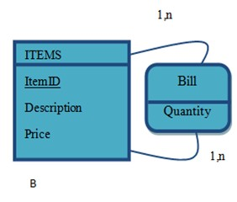
Many to Many (M:N) Unary Relationship
For a unary (M:N) relationship, we model the entity as one table.Then we create a separate table (a relation) to represent the (M:N) relationship.The primary key of this new relation is a composite key that consists of two attributes (which need not have the same name) that both take their values from the same primary key. Any attribute associated with the relationship such as Quantity is included as a non-key attribute in this new relation.We can express the result for as follows:
ITEMS (ItemID, Description, Price)
ITEM-BILL (ItemID, Item_Number, Quantity)

Slide 26
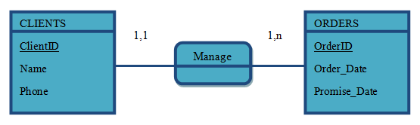
Transforming Binary and Higher-Degree Relationships
(1:N) Binary Relationships
Consider the following (1:N) relationship. In this case, the entity that contains instances that can be in relationship just one time (in this case ORDERS) will inherit the primary key of the other entity to become its foreign key.
CLIENTS (ClientID, Name, Phone)
ORDERS (OrderID, Order_Date, Promise_Date, ClientID#)

Slide 27
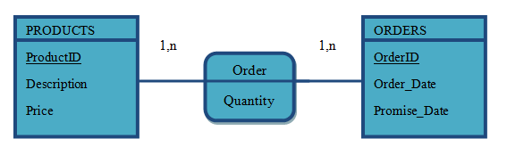
(M:N) Binary Relationships
Suppose that a binary many-to-many (M:N) relationship (or associative entity) exists between two entities A and B. For such a relationship, we create a separate relation C. The primary key of this relation is a composite key consisting of the primary key for each of the two entities in the relationship. Any non-key attributes that are associated with the (M:N) relationship are included with the relation C.
PRODUCTS (ProductID, Description, Price) ORDER (OrderID, ProductID, Quantity) ORDERS (OrderID, Order_Date, Promise_Date)

Slide 28
Higher-Degree Relationships
In some cases, a relationship may be found among three or more entities. In such cases, we create a separate relation that has as a primary key the composite of the primary keys of each of the participating entities, plus any additional non-key elements (if exist). This rule is a simple generalization of the rule for a binary M:N relationship.

Slide 29


59

